Slide 1
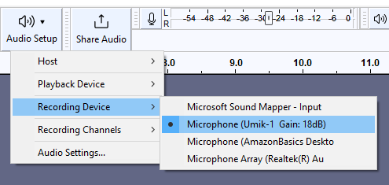


While Waiting to begin:
1. Open Audacity:
Found on computer, not 105 folder!
2. Make sure your mic is on, connected to the computer, and selected as the recording device!

Slide 2
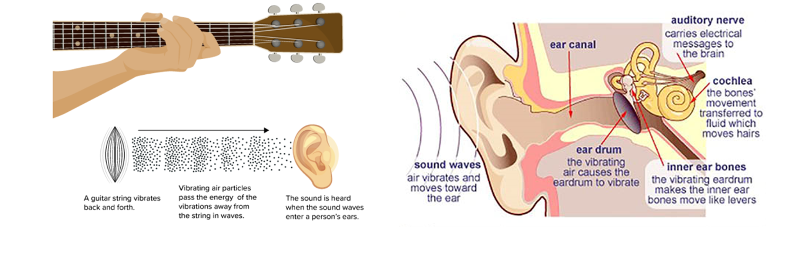
Lab 4:Physics and Physiology of Sound

Slide 3
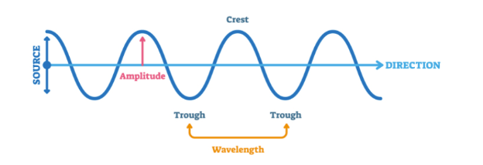


Part 1: Sound Physics
Sound: mechanical vibration, e.g. density/pressure oscillations in air, seismic vibrations of the earth, oscillations of a plucked string.
Properties: Sound waves have an intensity (loudness), frequency (pitch), wavelength, and propagation speed.
$$c_{s}$$
$$fλ=c_{s}$$
$$c_{s, air}≈344 m/s$$

Slide 4
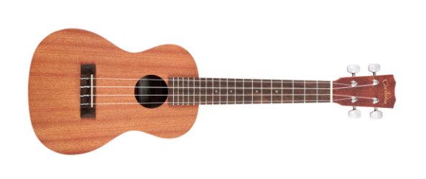
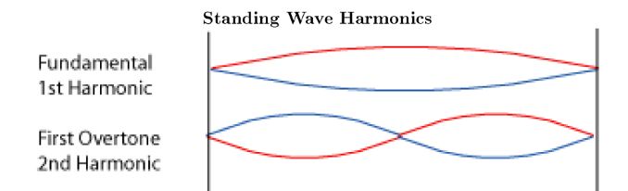
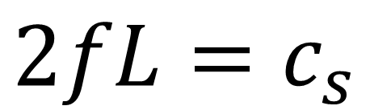

Part 1: Sound Physics
Waves on a String: For fixed endpoints, we have a fixed set of wavelengths, and the sound speed can be calculated from tension/mass
Harmonics: When a string is plucked, all harmonics play are excited but typically the fundamental frequency is the loudest!
$$c_{s}$$
$$2fL=c_{s}$$
$$c_{s}=\sqrt{\frac{T}{μ}}$$

Slide 5
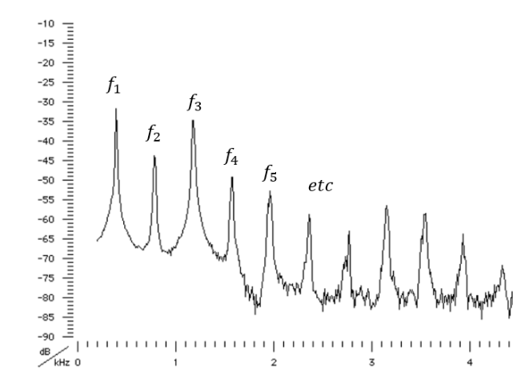

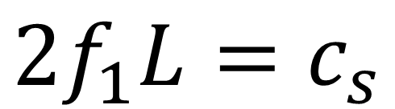

Part 1: Sound Physics
Spectrum: A plot of intensity vs. frequency is called spectrum.
$$f_{1}$$
$$2f_{1}L=c_{s}$$

Slide 6
Part 1: Sound Physics
Goal: Pick two strings and measure their “sound speeds” and compare
→What are some ways to do this?
Conclusion: Check the tension and/or mass density and compare (quick check)
$$c_{s}$$
$$2fL=c_{s}$$
$$c_{s}=\sqrt{\frac{T}{μ}}$$

Slide 7


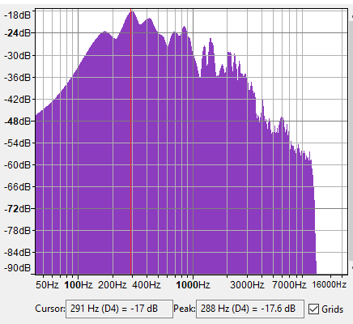
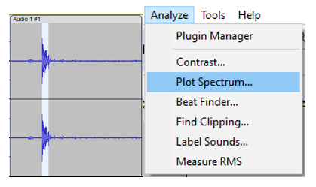
Measuring Frequency using Audacity
Configure Microphones
Open Audacity
Click Record:
Do you perceive it as equally loud at all frequencies?
Plot Spectrum: Is it detected that way?

Slide 8
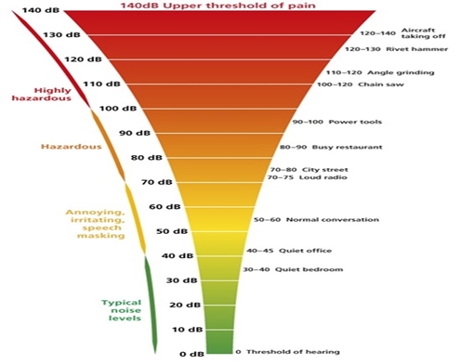
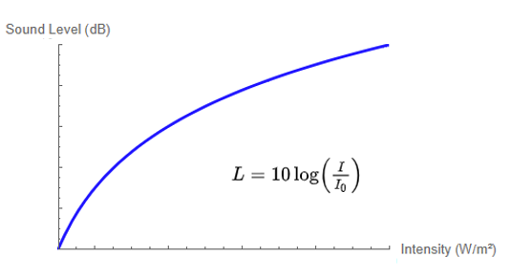
Part 2: Sound Perception
Perception: Distinct from physical stimulus
Units: Often have associated units, for Example the Decibel
But why logarithmic???????

Slide 9
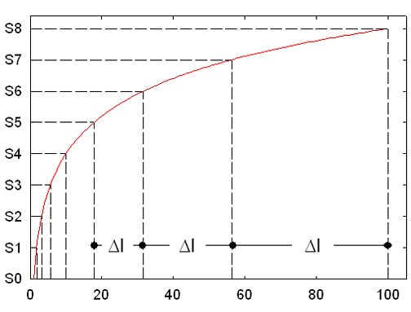
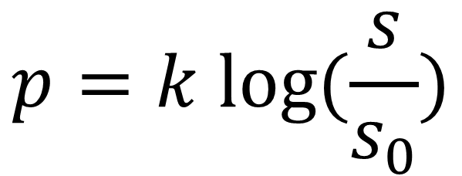
Part 2: Sound Perception
Weber-Fechner Law: “Quasi-universal” logarithmic relation
Examples: Loudness/brightness, weight perception (pressure), and pitch(?)
Context: Origin and accuracy subject of current study (psychophysics, critical brain hypothesis)
$$p=k log⁡(\frac{s}{s_{0}})$$

Slide 10
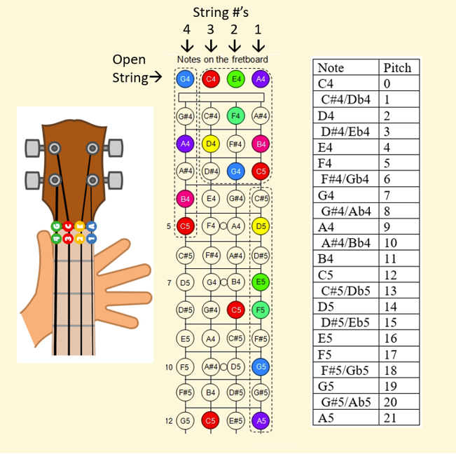
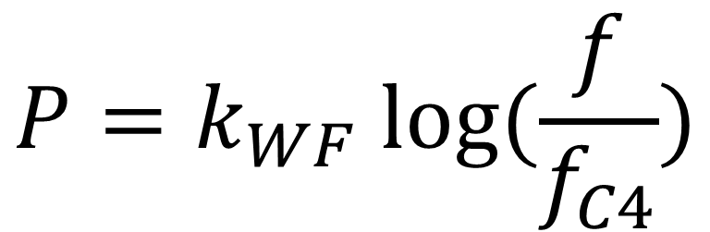
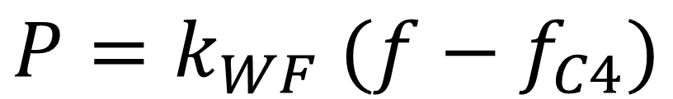
Part 2: Sound Perception
Goal: Compare data with linear and WF Law
→How would we test this?
OR
$$P=k_{WF} (f−f_{C4})$$
$$P=k_{WF} log⁡(\frac{f}{f_{C4}})$$

Slide 11

Extra Credit: Sound Perception
Consequence of Weber-Fechner Law: Incremental small changes in loudness become exponentially large in intensity! Hearing damage can happen fast!
Free Hearing Exam: And +3/30 extra credit points for completion

